Slide 1
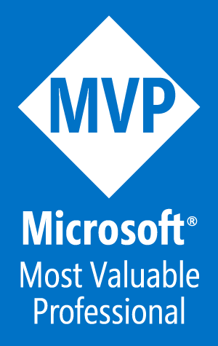
View VM Information using PowerShell
Using PowerShell to Virtual Machine Information in Hyper-V and Azure Environments
Robert Borges (MVP)

Slide 2


Who am I
Robert “Bob” Borges
Follow Me:
Chief Information Officer Bay State Integrated Technology, Inc.
2017 Microsoft MVP Awarded for Azure
President of Boston User Groups, Inc.
President of IT-Pro User Group
Blog: www.RobertBorges.us
E-mail: Bob@RobertBorges.us
Twitter: @RobertBorges_us
LinkedIn: linkedin.com/in/robert-borges

Slide 3
Why PowerShell for This?
Built-in GUI tools are great for monitoring live performance, but not as good at displaying usage stats Example: Show disk space usage for all VMs
Get verbose levels of information and feed them into the tools you prefer (Excel, Access, Visual Basic, etc.)
Quickly get information Example: on virtual machines throughout your organization

Slide 4
Considerations
What version of Windows Server are running on your Hyper-V hosts?
What version of PowerShell are you running?
Install Hyper-V on Windows Server:
Get-WindowsFeature Hyper-V
Install-WindowsFeature Hyper-V –Restart
Install Hyper-V on Windows 10:
Get-WindowsOptionalFeature -FeatureName "Microsoft-Hyper-V*" -online | Format-Table
Enable-WindowsOptionalFeature -Online -FeatureName Microsoft-Hyper-V –All
Azure PowerShell Installed?
http://bit.ly/2qAxgzP

Slide 5
Definitions
“PS” = PowerShell
“VM” = Virtual Machine
“Host” = Hypervisor host running either:
Windows Server with the Hyper-V Role
Microsoft Hyper-V Server
“ARM” = Azure Resource Manager
The new management portal for Microsoft Azure - https://portal.azure.com

Slide 6
Start/Stop a Virtual Machine
Hyper-V: Start a VM: Start-VM –ComputerName localhost –Name “Audit PC 1”
Hyper-V: Stop a VM: Stop-VM –ComputerName localhost –Name “Audit PC 1”
Azure: Start a VM: Start-AzureRmVM –ResourceGroupName “PowerShell-in-Action-Boston” –Name PSinActionVM1
Azure: Stop a VM Stop-AzureRmVM –ResourceGroupName “PowerShell-in-Action-Boston” –Name PSinActionVM1

Slide 7
Hyper-V
PowerShell Cmdlets for Hyper-V

Slide 8
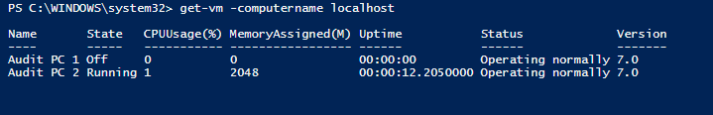
Hyper-V: Get-VM
GET-VM gets the virtual machines from one or more Hyper-V hosts.
SYNTAX:
Get-VM [[-Name] <string[]>] [-CimSession <CimSession[]>] [-ComputerName <string[]>] [-Credential <pscredential[]>] [<CommonParameters>]

Slide 9
Hyper-V: Get-VM Examples
View Status of a single VM: Get-VM -ComputerName localhost -Name "Audit PC 1“
View Status of all VMs on multiple Hyper-V Hosts: Get-VM -ComputerName localhost,bostonhost1,bostonhost2
View Running VMs: Get-VM | Where { $_.State –eq ‘Running’ }

Slide 10
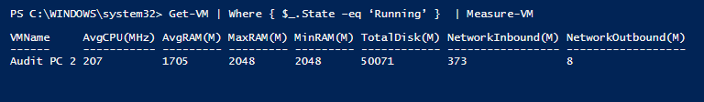
Hyper-V: View Stats of Running Vm
Get-VM | Where { $_.State –eq ‘Running’ } | Measure-VM

Slide 11

Hyper-V: View VM and IP Addresses
Get-VM | Select -ExpandProperty NetworkAdapters | Select VMName, IPAddresses, Status

Slide 12
Azure
PowerShell Cmdlets for Azure ARM Virtual Machines

Slide 13
Azure: Get-AzureRmVM
The Get-AzureRmVM cmdlet gets the model view and instance view of an Azure virtual machine. The model view is the user specified properties of the virtual machine.
SYNTAX:
Get-AzureRmVM
[-ResourceGroupName] <String>
[-Name] <String>
[-Status]
[-DisplayHint <DisplayHintType>]
[<CommonParameters>]

Slide 14
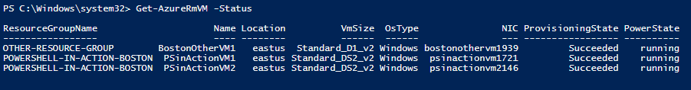
Get-AzureRmVM Examples:
List all VMs in all Resource Groups: Get-AzureRmVM
List VMs in an Azure Resource Group: Get-AzureRmVM -ResourceGroupName "PowerShell-in-Action-Boston“
View Running Status of All Azure VMs: Get-AzureRmVM -Status

Slide 15

Azure: View VM Ip Addresses
$vms = get-azurermvm
$nics = get-azurermnetworkinterface | where VirtualMachine -NE $null #skip Nics with no VM
foreach($nic in $nics)
{
$vm = $vms | where-object -Property Id -EQ $nic.VirtualMachine.id
$prv = $nic.IpConfigurations | select-object -ExpandProperty PrivateIpAddress
$alloc = $nic.IpConfigurations | select-object -ExpandProperty PrivateIpAllocationMethod
Write-Output "$($vm.Name) : $prv , $alloc"
}

Slide 16
Example Script
HYPER-V SAMPLES
# Start/Stop a Hyper-V VM
Start-VM –ComputerName localhost –Name “Audit PC 1”
Stop-VM –ComputerName localhost –Name “Audit PC 1”
# Start all VMs
Start-VM -ComputerName localhost -Name *
# Stop all VMs
Stop-VM -ComputerName localhost -Name
# View Status of a single VM
Measure-VM -ComputerName localhost -Name "Lab1"
#View Status of all VMs on multiple Hyper-V Hosts
Get-VM -ComputerName localhost,bostonhost1,bostonhost2
# View Running VMs
Get-VM | Where { $_.State –eq ‘Running’ }
# View VM IP Addresses
Get-VM | Select -ExpandProperty NetworkAdapters | Select VMName, IPAddresses, Status
AZURE SAMPLES
#Install Azure PowerShell
Install-Module AzureRM
Import-Module AzureRM
#Login to Azure Account
Login-AzureRmAccount
#Start/Stop Azure VMs
Stop-AzureRmVM -ResourceGroupName "PowerShell-in-Action-Boston" -Name PSinActionVM1
Start-AzureRmVM -ResourceGroupName "PowerShell-in-Action-Boston" -Name PSinActionVM1
#List VMs in an Azure Resource Group
Get-AzureRmVM -ResourceGroupName PowerShell-in-Action-Boston
#View Status of Azure VMs
Get-AzureRmVM -Status
#Display IP Addresses of Azure VMs (by Rhoderick Milne of MSFT)
$vms = get-azurermvm
$nics = get-azurermnetworkinterface | where VirtualMachine -NE $null #skip Nics with no VM
foreach($nic in $nics)
{
$vm = $vms | where-object -Property Id -EQ $nic.VirtualMachine.id
$prv = $nic.IpConfigurations | select-object -ExpandProperty PrivateIpAddress
$alloc = $nic.IpConfigurations | select-object -ExpandProperty PrivateIpAllocationMethod
Write-Output "$($vm.Name) : $prv , $alloc"
}
#

Slide 17

Next Steps
Take these code snippets and make them serve your own purpose
Monitor usage of multiple VMs on multiple hosts

Slide 18
Giveaway: $100 of Azure Credit for 1 month
See Bob for code. Expires 8/28/2017
DO NOT redeem promo code with an email account that is attached to an EA (electronic agreement), the pass will not work.
Promo code needs to be redeemed within by expiration date listed.
Only one promo code can be redeemed per the lifetime of a Live ID/Org ID.
Monetary credit can't be used toward third party services, premier support or Azure MarketPlace and cannot be added to existing subscriptions.
Accounts cannot be extended - the duration and monetary credit amount cannot be altered
If you remove the monetary cap by providing a payment instrument, you will be converted to a 'Pay-as-you-go' account at the end of the offer duration. However, if the account has expired, you will need to create a support ticket to enable conversion.
Offers are not customizable.
Subscriptions are activated within minutes of the promo code being redeemed.
To redeem a promo code, visit www.microsoftazurepass.com

Slide 19
Questions?

